Slide 1
Weighted least squares
Parastoo Bybordi
Regression2
Spring 2021

Slide 2
INTRODUCTION
Ordinary least squares: To estimate the regression coefficients, the sum of the second power of the fitting errors is zero. Normal equations are obtained and coefficients are estimated.
When can we not use OLS?
One of the common assumptions in the modeling process(Least Square), both linear and nonlinear, is that each data point provides equally accurate information about the determinant of the whole process.. In other words, it is assumed that the standard deviation of the error term is constant on all values of the predictive or explanatory variables. But this assumption does not apply to some models.
In the typical regression model, Y = β0 + β1Xi + εi, random errors can be evenly distributed and independent with constant variance. When this assumption is violated, then OLS estimators of regression coefficients lose the property of least variance among all unbiased linear estimators (according to Gauss-Markov theorem, they are not BLUE).

Slide 3
INTRODUCTION
Violation of such an assumption can occur in any of the following situations:
The variance of the random error components is not constant.
Random error components are not independent.
Random error components have no fixed variance and are not independent.
In such cases, the covariance matrix of the random error components does not remain in the form of the identity matrix but can be considered as any positive-definite matrix. Under such an assumption, the OLS estimation does not remain as efficient as the identity covariance matrix. In such cases, the GLS or WLS method is used to estimate the model parameters to estimate the model parameters.

Slide 4
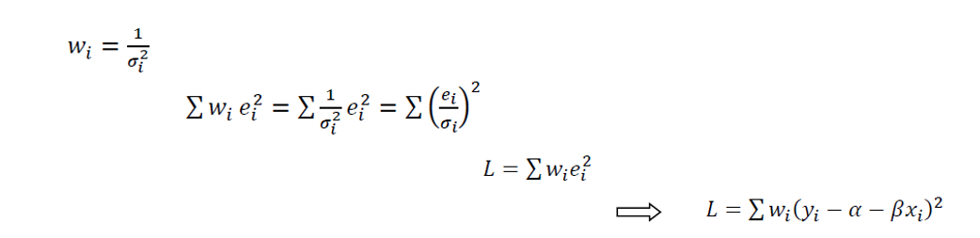
Weighted least squares
Weighted Least Squares is a method that deals with observations which have non-constant variance. Suppose Y = a + bx_{i} + ε_{i} and the variances are not constant, and the observed variance of i is equal to σ_{i} ², then:

Slide 5
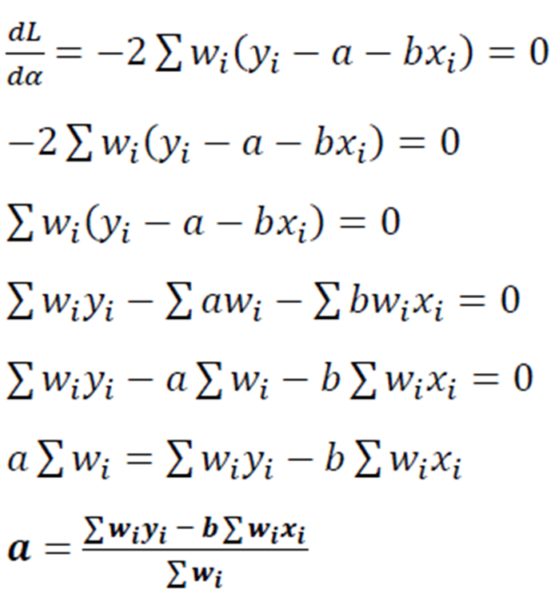
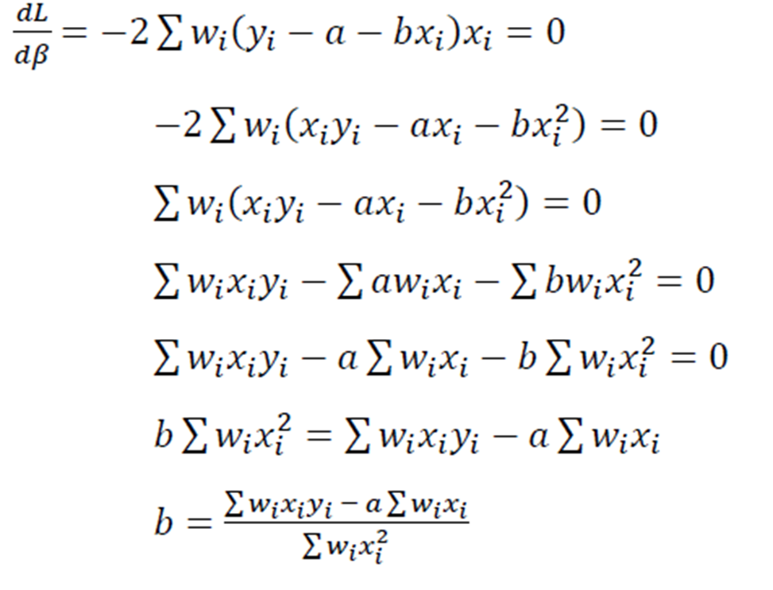
Weighted least squares

Slide 6
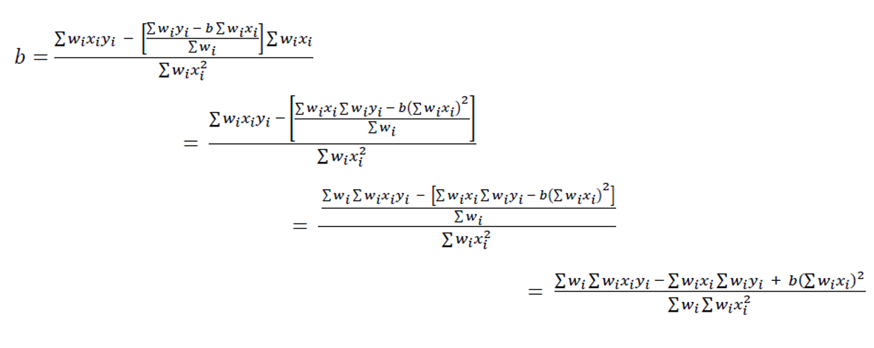
Weighted least squares

Slide 7
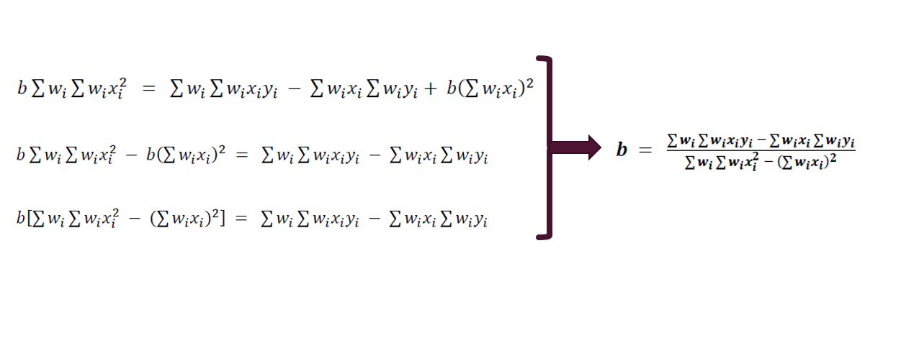
Weighted least squares

Slide 8
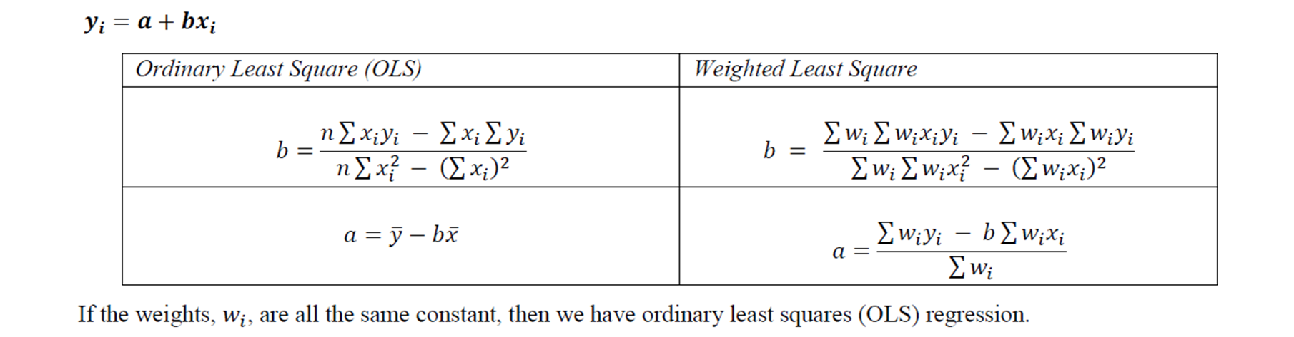
Differences between OLS and WLS

Slide 9
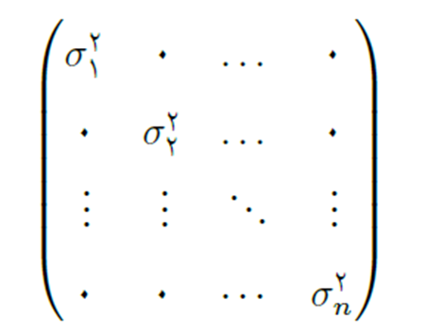

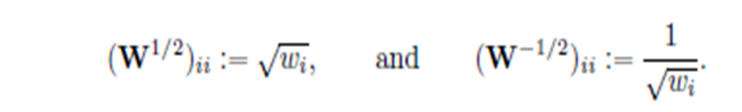
Multivariate coefficient estimators
Assume that the covariance matrix of variance is :
In this case, suppose:

Slide 10
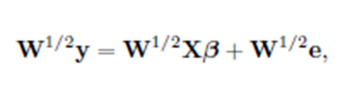

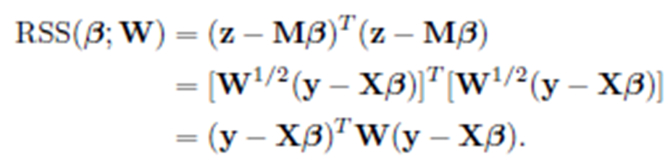
Multivariate coefficient estimators
If we multiply the matrix W^{1 / 2} on the equation from the left, we have:
We have:
So:

Slide 11
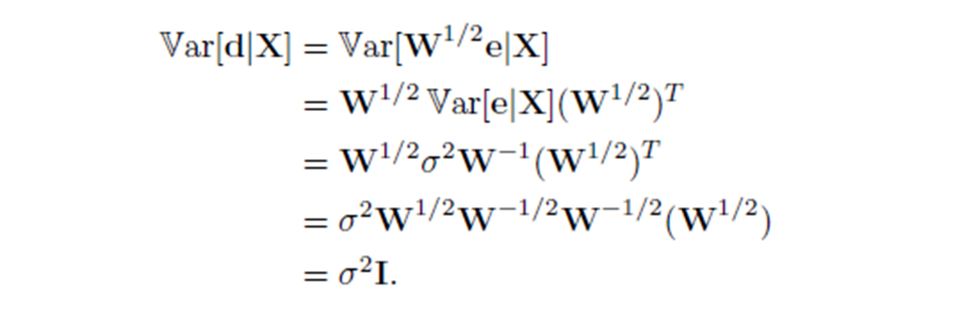
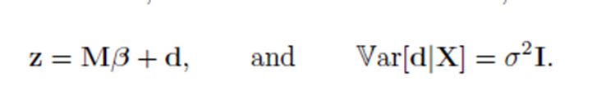
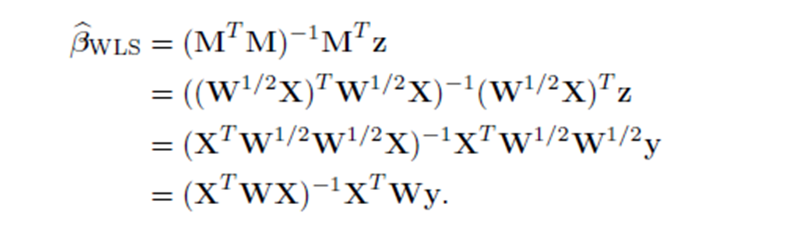
Multivariate coefficient estimators
WLS estimator is equal to:

Slide 12
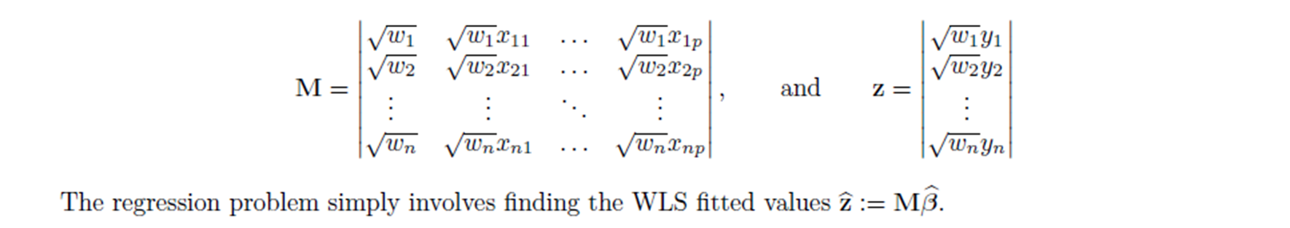

Multivariate coefficient estimators
And the vector of observations and variables is as follows:
Note: The first assumption of regression ( )was established and with these transformations the problem of variance changes and the second assumption is established. Under these two assumptions, according to Gauss-Markov theorem, this estimator is also BLUE.

Slide 13
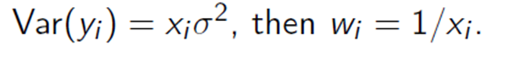
Finding weights
If the i-th response is an average of n_{i} equal to the observed variables.,then:
If y_{i} is the sum of n_{i} observations, then:
If the variance is proportional to some of the predictor variables xi, then:

Slide 14
References
https://towardsdatascience.com/when-and-how-to-use-weighted-least-squares-wls-models-a68808b1a89d
http://www.statpower.net/Content/313/Lecture%20Notes/WLS.pdf
http://www.philender.com/courses/linearmodels/notes3/wls.html
linear regression analysis theory and computing(Xin Yan, Xiaogang Su)
https://www.stat.cmu.edu/~cshalizi/mreg/15/lectures/24/lecture-24--25.pdf
https://nptel.ac.in/content/storage2/courses/111104074/Module7/Lecture25.pdf
https://www.stat.cmu.edu/~cshalizi/350/lectures/18/lecture-18.pdf
http://www.eviews.com/help/helpintro.html#page/content/Regress2-Weighted_Least_Squares.html
Application of Weighted Least Squares Regression in Forecasting.(Sulaimon Mutiu O.
Department of Statistics & Mathematics Moshood Abiola Polytechnic, Abeokuta, Ogun State, Nigeria)

